Slide 1
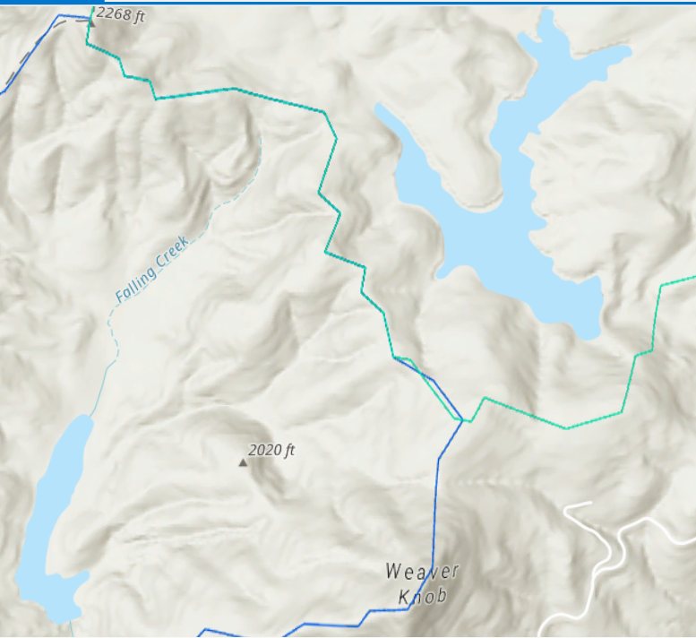
B200
1.72/1.72
B100
0.52
Chlorophyll-a concentrations from 29APR19 continuum day
B30
2.1/2.2
B20
1.9
B45
2.9
B01
2.2
F102
2.23
F101
1.72
B50
2.9
F200
0.98
F20
2.06
F100
1.5/1.23
F99
0.98
F30
2.2
F45
2.2
F50
2.06/2.2
F01
1.5

Slide 2
B200
1.7/1.7
B100
0.52
Chlorophyll-a concentrations from 30May19 continuum day
B30
1.7/1.7
B20
1.5
B45
1.03
B01
1.03
F102
0.9
F101
0.5
B50
1.4
F200
0.7
F20
4.8
F100
0.7/0.5
F99
0.5
F30
4.6
F45
4.6/4.5
F50
3.8
F01
0.9
Notes:
Think about the magnitude of change along the cont within the reservoir, secchi at deep hole for both days as a measure of water clarity

